Slide 1
Phone Directory
Data Structures and Algorithms
Group 20
Muhammad Hammad Tahir
Aqsa Saeed
Noor Fatima

Slide 2
Features
Add new contact information
Search contact information of specific person
Remove existing contact information
View all contact’s information

Slide 3
About Phone Directory
Main concern is space efficiency to store more contact information
Can tolerate the little time delay
Can’t tolerate the space wastage
Use Binary Search Tree (BST) and SET data structures

Slide 4
Binary Search Tree:
A Binary Search Tree is a binary tree with nodes having at most two children: left and right.
The key property is that each node's left subtree contains elements less than the node, and its right subtree contains elements greater than the node.
Sets:
Uniqueness.
No duplicate item is allowed to store in the SETs
4

Slide 5
Analysis
Insertion and deletion operations also have an average time complexity of O(Height of Tree) or O(log n), ensuring efficient updates to the tree.
BST allows efficient search operations with an average time complexity of O(Height of Tree) or O(log n).
BST worst case will take O(N).
SET insertion and deletion will take O(N).
SET searching will take O(N).
Space complexity for BST is O(N).
Space complexity for SET is O(N).

Slide 6
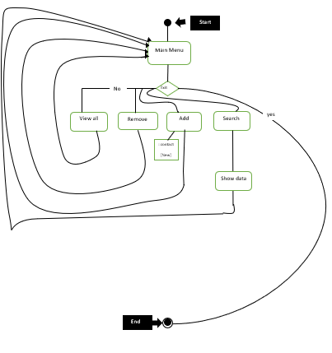
Flow Diagram

Slide 7
Algorithms for New Data Structure (SET)
Add to Set:
Algorithm AddToSet( element):
Input: element (data to be added)
if not Contains( element):
newNode = CreateNode(element)
if set->head is NULL:
set->head = newNode
else:
currentNode = set.head
while currentNode->next is not NULL:
currentNode = currentNode->next
currentNode->next = newNode
else:
DisplayDuplicateElementMessage()

Slide 8
Algorithms for New Data Structure (SET)
Contain Function of Set:
Algorithm Contains( element):
Input: element (data to be checked)
currentNode = set->head
while currentNode is not NULL and currentNode.element is not equal to element:
currentNode = currentNode->next
if currentNode is not Null
return true
Else
return false

Slide 9
Algorithms for New Data Structure (SET)
Add to Set:
Algorithm AddToSet( element):
Input: element (data to be added)
if not Contains( element):
newNode = CreateNode(element)
if set->head is NULL:
set->head = newNode
else:
currentNode = set.head
while currentNode->next is not NULL:
currentNode = currentNode->next
currentNode->next = newNode
else:
DisplayDuplicateElementMessage()

Slide 10
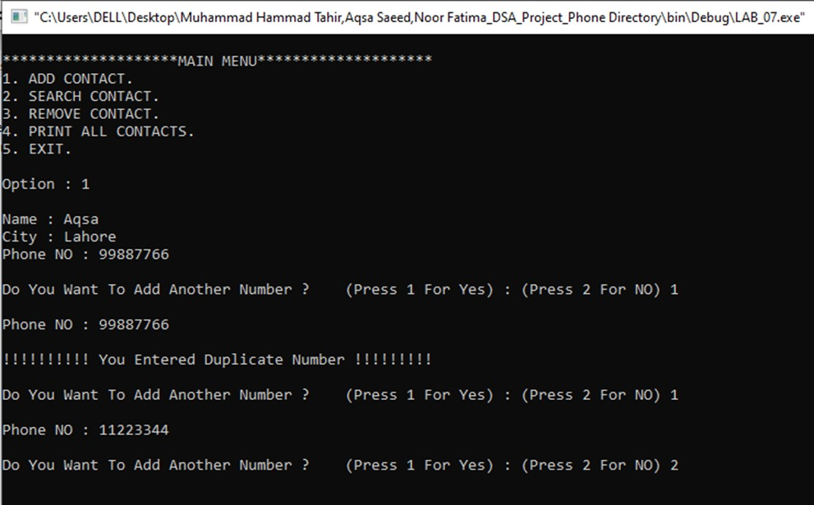
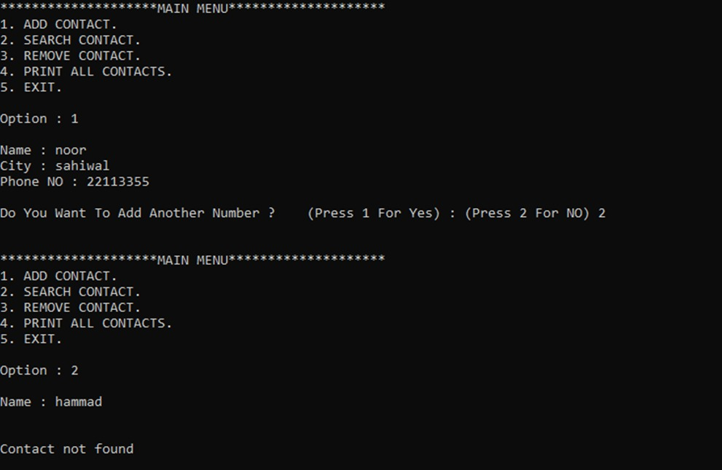
Program Output:

Slide 11
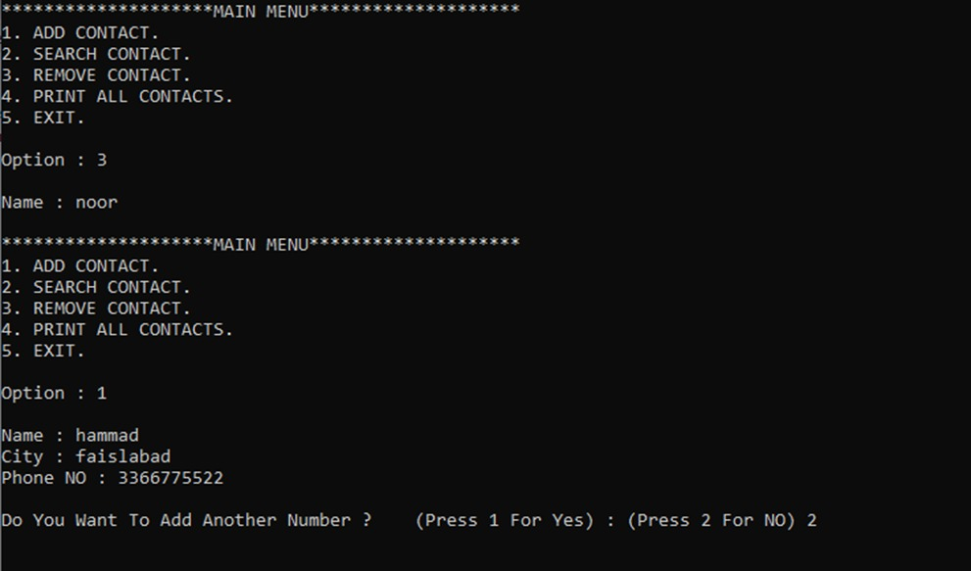
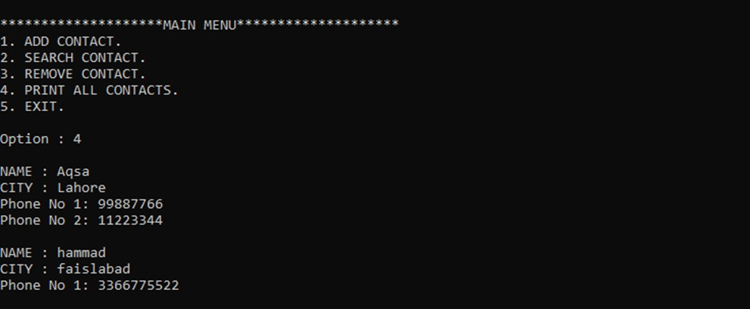
Program Output:

Slide 12
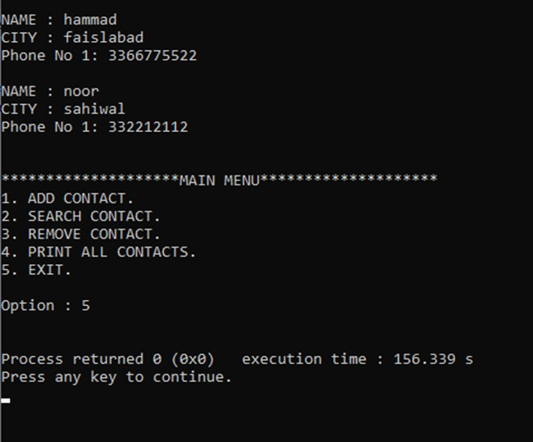
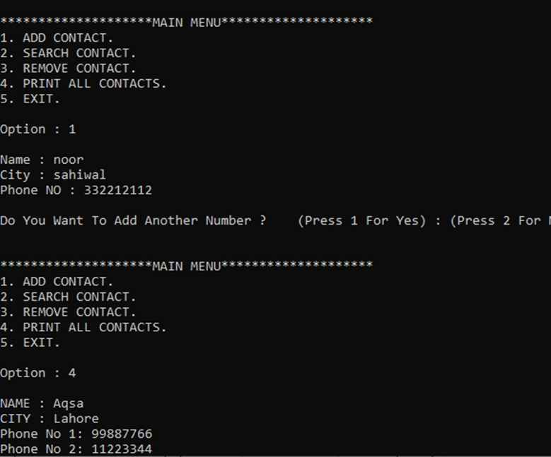
Program Output:

Slide 13
THANK YOU!

